Slide 1
Qlik Alerting™
Take Intelligent, Timely Action
April 2020

Slide 2
Legal Disclaimer
Qlik® roadmaps provide a general overview of our anticipated product direction as of the date hereof. Qlik undertakes no intention or obligation to update or revise any forward-looking statements contained herein, whether as a result of new information, future events or otherwise.
The information contained in Qlik roadmaps is the proprietary information of Qlik and is not to be used for any reason other than to provide our customers, prospective customers, partners and strategic partners with a general overview of our anticipated future offerings. Our roadmaps are not a commitment, promise or other obligation on the part of Qlik to deliver any particular code or functionality. Furthermore, Qlik makes no commitment that any future functionality may be made available as part of maintenance and support.
Roadmap information should not be relied on in making a purchasing decision, as the development, release, and timing of any features or functionality described for Qlik’s products remains at our sole discretion.
© 2020 QlikTech International AB. All rights reserved. All product and company names are trademarks™ or registered® trademarks of their respective holders.

Slide 3
Announced in January 2020
+
Notes:
In January 2020, Qlik announced the acquisition of RoxAI and its Ping intelligent alerting software. To be re-branded as Qlik Alerting, this capability delivers intelligent, actionable alerting capabilities in Qlik Sense, as both self-service and centrally managed alerts. With Qlik Alerting, our customers will benefit from an enhanced ability to proactively monitor and manage their business through exception, to make faster decisions and take action.

Slide 4
Introducing Qlik Alerting™
Take intelligent, timely action
Sophisticated, data-driven alerts
Advanced statistical calculation for outlier and anomaly detection
Drill into dimension values
Self service and centralized insights
In-context linking to analytics applications
Enables management by exception
Decreases “dashboard fatigue”
Drives adoption and action
Notes:
Qlik Alerting is an intelligent alerting platform for Qlik Sense, providing sophisticated, data-driven alerts that help users more proactively monitor their business and take timely action.
It goes way beyond simple KPI thresholds, featuring advanced statistical calculation and trending that easily spots outliers and anomalies, comparisons and complex nested alert logic, and the ability to drill into and evaluate individual dimension values. Users can create self-service alerts through Qlik Sense, and organizations can centrally configure and manage alerting for widespread distribution, delivered through email and secure mobile apps. Leveraging our unique Associative Engine, alerts are context-aware – factoring in specific selection states and providing links that take users directly to the right visualizations, with selections applied.
With Qlik Alerting, organizations can support management by exception, increasing the value of analytics by notifying users of potential issues, allowing them to immediately analyze further, and prompting action based on insight. They can decrease “dashboard fatigue” by driving users to the right analytics in the right context, promoting user engagement and adoption.

Slide 5
Where It Fits – Actionable Insights
Qlik’s end-to-end value chain
Free it
…
Find it
…
Understand it
…
Action it
Enterprise Data Integration
Business-Ready Data Catalog
Augmented Analytics
Embedded & Actionable Analytics
Trust It!
Intelligent alerting
Outlier and anomaly detection
Proactive management
Timely action
Workflow automation
Qlik Alerting™
Notes:
Qlik leads the market with an end-to-end data and analytics offering, from data preparation and integration, to AI-driven insights, to actioning and operationalizing findings. With Qlik Alerting, Qlik has expanded our ability to deliver real-time, data-driven insights for action. Through intelligent alerting with sophisticated features such as outlier and anomaly detection, we can offer our customers, we enable our customers to more proactively monitor and manage their business and take timely action where and when they can make a difference to business success.
In the future, we plans to integrate Ping with workflow and robotic process automation (RPA) solutions through APIs that will further accelerate the business value customer data.

Slide 6
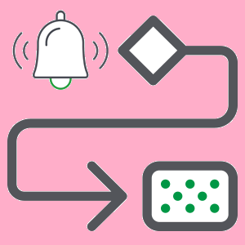
Qlik Alerting
Take Intelligent, Timely Action
Sophisticated, Intelligent Alerts
Self-Service and Centralized Insights
Drive Adoption and Action
Powerful Data-Driven Alerts
Advanced Statistical Calculation
Drill Into Dimension
Self-Service Alerting
Centralized Alerting & Administration
Email and Mobile Delivery
Manage by exception
Decrease “dashboard fatigue”
Promote user engagement with data
Notes:
Qlik Alerting offers intelligent, data-driven alerts that help users more proactively monitor their business and take intelligent, timely action.
Sophisticated, Intelligent Alerts
Qlik Alerting allows users and organizations to create powerful, data-driven alerts with sophisticated alert criteria, leveraging advanced statistical calculation and outlier detection. This provides intelligent, context-aware alerting beyond simple KPI thresholds, allowing people to get notified of trends, outliers, and conditions in their data that may otherwise go unnoticed. And it offers visibility within dimensions on a per-value basis (e.g. which sales reps did not meet the criteria).
It features data-driven alerts with advanced statistical calculation and trending that easily spots outliers and anomalies. Alert conditions respect selection state (context) and can be created with not only simple calculations but also comparisons between measures, % increases and decreases, and nested and/or logic. Alerts can be set to run on a scheduled basis or upon application reloads. And our unique drill into dimension feature scans through all the values in a dimension, evaluating them against alert criteria and either grouping qualifying values together or sending individual alerts for each value.
Self-Service and Centralized Insights
Qlik Alerting supports self-service alerting for users, and provides centrally managed alerting for organizations, delivered through email and mobile apps. This supports users with a “pull” model, allowing them to self-serve, and organizations with a “push model, providing administrators the ability to broadcast insights to users. And it delivers alerts through multiple channels in a flexible fashion, either through customized emails or secure mobile apps.
A simple interface in Qlik Sense allows users to easily set up alerts for themselves, based on data they select. The Qlik Alerting application allows administrators to define and manage sophisticated, centralized data and system alerts, and distribute them to groups of users. Alerts can be delivered through both email and the Qlik Alerting mobile app. Organizations can create custom email templates for specific alerts to customize information, look and feel. And the mobile app is available for iOS and Android, with support for push notifications and a secure, BlackBerry EMM version.
Drive Adoption and Action
With Qlik Alerting, organizations can support management by exception and decrease “dashboard fatigue” through proactive monitoring and in-context linking to analytics applications. This increases adoption and value of analytics by notifying users and managers when potential issues arise, allowing them to analyze further, in context, and take action based on the insights uncovered.
Unlike alerting capabilities in other products, Qlik Alerting is data-driven, not tied to specific visualizations. Query-based viz tools typically limit the data that can be used to certain fields and visualization types. Qlik Alerting enables true management by exception, as advanced calculation conditions can be run across all your data. And, through our Associative Engine, Qlik Alerting is context-aware, supporting alerts for not only the global data set but also specific selection states. Links provided in alerts bring users directly to the right analytics, with the appropriate context (selection state) applied, facilitating immediate follow-up analysis.

Slide 7
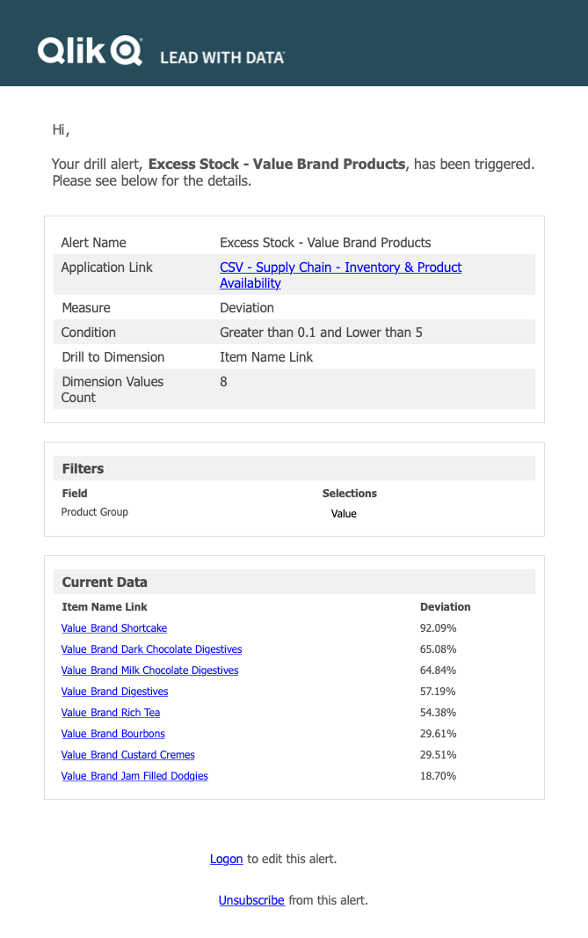
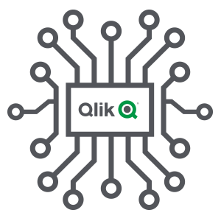
Sophisticated, Intelligent Alerts
Powerful, data-driven alerting
Advanced statistical calculation and trending for outlier and anomaly detection
Comparisons and complex nested alert logic
Drill-into dimension values
Deliver multiple dimension values grouped in a single alert
Loop through dimension values to trigger multiple alerts
Context-awareness – alerts run based on specific selection states
Notes:
Qlik Alerting allows users and organizations to create powerful, data-driven alerts with sophisticated alert criteria, leveraging advanced statistical calculation and outlier detection. This provides intelligent, context-aware alerting beyond simple KPI thresholds, allowing people to get notified of trends, outliers, and conditions in their data that may otherwise go unnoticed. And it offers visibility within dimensions on a per-value basis (e.g. which sales reps did not meet the criteria).
It features data-driven alerts with advanced statistical calculation and trending that easily spots outliers and anomalies. Alert conditions respect selection state (context) and can be created with not only simple calculations but also comparisons between measures, % increases and decreases, and nested and/or logic. Alerts can be set to run on a scheduled basis or upon application reloads. And our unique drill into dimension feature scans through all the values in a dimension, evaluating them against alert criteria and either grouping qualifying values together or sending individual alerts for each value.

Slide 8
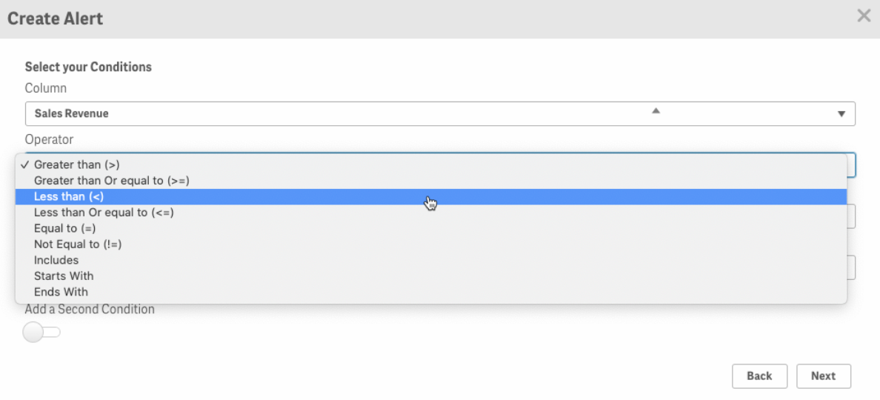
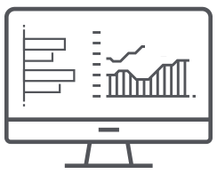
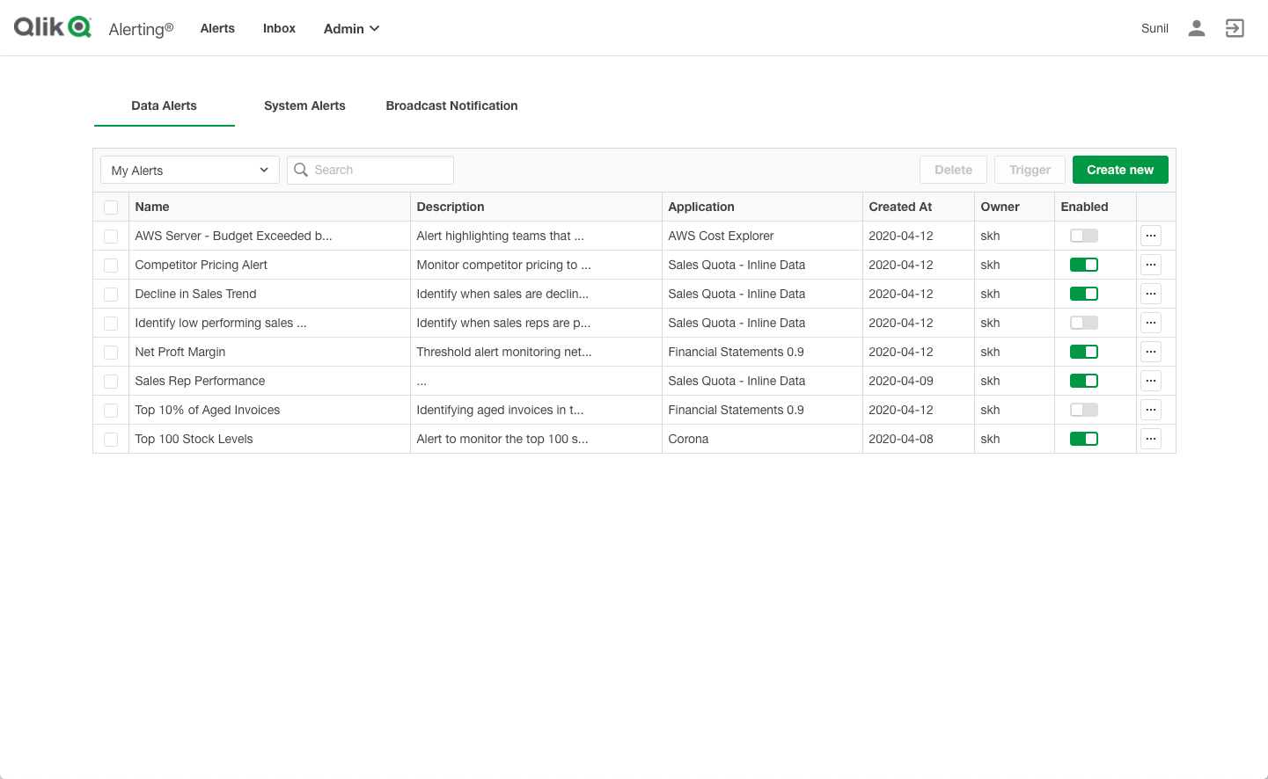
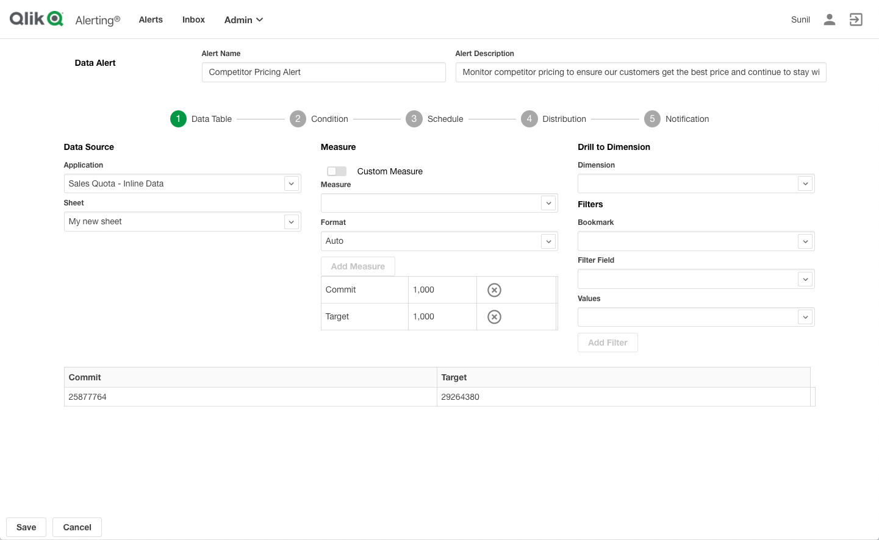
Self-Service and Centralized Insights
Self-Service Alerting
Available through Qlik Sense UI
Centralized Alerting & Administration
Robust application for centralized alert setup and administration
Email and Mobile Delivery
System alerts and notifications
Scheduled or run on app reloads
Dedicated mobile apps
For iOS and Android
Push notifications
Notes:
Qlik Alerting supports self-service alerting for users, and provides centrally managed alerting for organizations, delivered through email and mobile apps. This supports users with a “pull” model, allowing them to self-serve, and organizations with a “push model, providing administrators the ability to broadcast insights to users. And it delivers alerts through multiple channels in a flexible fashion, either through customized emails or secure mobile apps, on a scheduled basis or run on Qlik Sense app reloads.
A simple interface in Qlik Sense allows users to easily set up alerts for themselves, based on data they select. The Qlik Alerting application allows administrators to define and manage sophisticated, centralized data and system alerts, and distribute them to groups of users. Alerts can be delivered through both email and the Qlik Alerting mobile app. Organizations can create custom email templates for specific alerts to customize information, look and feel. And the mobile app is available for iOS and Android, with support for push notifications in a secure, native app.

Slide 9
Drive Adoption and Action
Enable management by exception
Proactively monitor and manage the business
Unlike other products alerts are data-driven, not tied to specific visualizations
Decreases “dashboard fatigue”
Through in-context linking to analytics applications
To the right sheet, with the right selection state applied
Promotes user engagement, data-driven decisions, and action based on insight
Notes:
With Qlik Alerting, organizations can support management by exception and decrease “dashboard fatigue” through proactive monitoring and in-context linking to analytics applications. This increases adoption and value of analytics by notifying users and managers when potential issues arise, allowing them to analyze further, in context, and take action based on the insights uncovered.
Unlike alerting capabilities in other products, Qlik Alerting is data-driven, not tied to specific visualizations. Query-based viz tools typically limit the data that can be used to certain fields and visualization types. Qlik Alerting enables true management by exception, as advanced calculation conditions can be run across all your data. And, through our Associative Engine, Qlik Alerting is context-aware, supporting alerts for not only the global data set but also specific selection states. Links provided in alerts bring users directly to the right analytics, with the appropriate context (selection state) applied, facilitating immediate follow-up analysis.

Slide 10
What Makes It Different
Data-driven alerting combined with our Associative Engine
Data Driven – Unlike alerting from competitors, Qlik Alerting is based off data and not visualizations
In other products, alerts are tied to visualizations
Only certain visualizations are supported
If a user wants to create an alert, they are forced to use a specific visualization
Context Awareness – Qlik Alerting provides in-context linking to dashboards for further exploration
Users are directed to the right sheet, with the selection state applied
Competing products do not apply global selections leaving users without context
Notes:
Qlik Alerting offers several advantages over alerting capabilities from second-generation visualization tools.
First, alerts are truly data driven. Other products claim to have data-driven alerting, but alerts are usually based off individual visualizations. This means that only limited data and certain types of visualizations are supported. With Qlik Alerting, powered by the Qlik Associative Engine, you can define sophisticated criteria across the entire data model, enabling true management by exception.
Second, alerts provided by Qlik Alerting are context-aware. Through the unique capabilities of our Associative Engine to understand and manage context, alerts that are defined respect selection state – triggering when criteria are met under a given selection state. Furthermore, links provided in alerts drive users back into the right visualizations with the same selections applied, so they can immediately investigate further. As in many areas, other products based on queries can’t match this unique behavior, leaving users without context as to why alerts fired or where to dig deeper.

Slide 11
Complete Alerting Capabilities
Qlik Sense Integration
Built on Qlik Sense APIs
Integrated Qlik Sense UI component
Security and governance
Self Service or Centralized
Mobile Apps
Self-service through Qlik Sense UI
Administrator managed through centralized app
iOS and Android
Native and secure
Push notifications
Linking to Qlik Sense Mobile app
Data-Driven Alerts
Complex alert conditions
Advanced statistical calculation
Detect trends and outliers
Drill into dimension
Alert Distribution
Email and mobile delivery
Scheduled alerts or on app reloads
Custom email templates
Broadcast notifications for large groups
System Alerts
Notify administrators and users upon system events
Notes:
Qlik Alerting provides a complete set of alerting capabilities for organizations of all types and sizes. These include:
Full integration with Qlik Sense – Qlik Alerting is built on the Qlik Sense APIs, the same open APIs that are used to build the core product. It includes an integrated UI component, and inherits all the security and governance of Qlik Sense itself.
Self Service or Centralized Alerting – Qlik Alerting offers both self-service through the Qlik Sense user interface, and administrator managed alerting through a centralized web app.
Data-Driven Alerts – Qlik Alerting supports complex alert conditions, advanced statistical calculation to detect trends and outliers, and our unique drill into dimension feature for evaluating individual dimension values.
System Alerts – Qlik Alerting also offers the ability to define, trigger, and distribute system alerts to administrators and interested users for system events and notifications.
Alert Distribution – Alerts can be distributed through both email and a dedicated mobile app. They can be scheduled or run on app reloads. Emails can be custom formatted, and broadcast notifications (non-personalized alerts) can be sent to large groups.
Mobile Apps – Qlik Alerting features a mobile app available on iOS and android. It is native and secure, and supports push notifications and direct linking to the Qlik Sense mobile app for further exploration on the go.

Slide 12
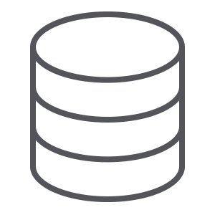
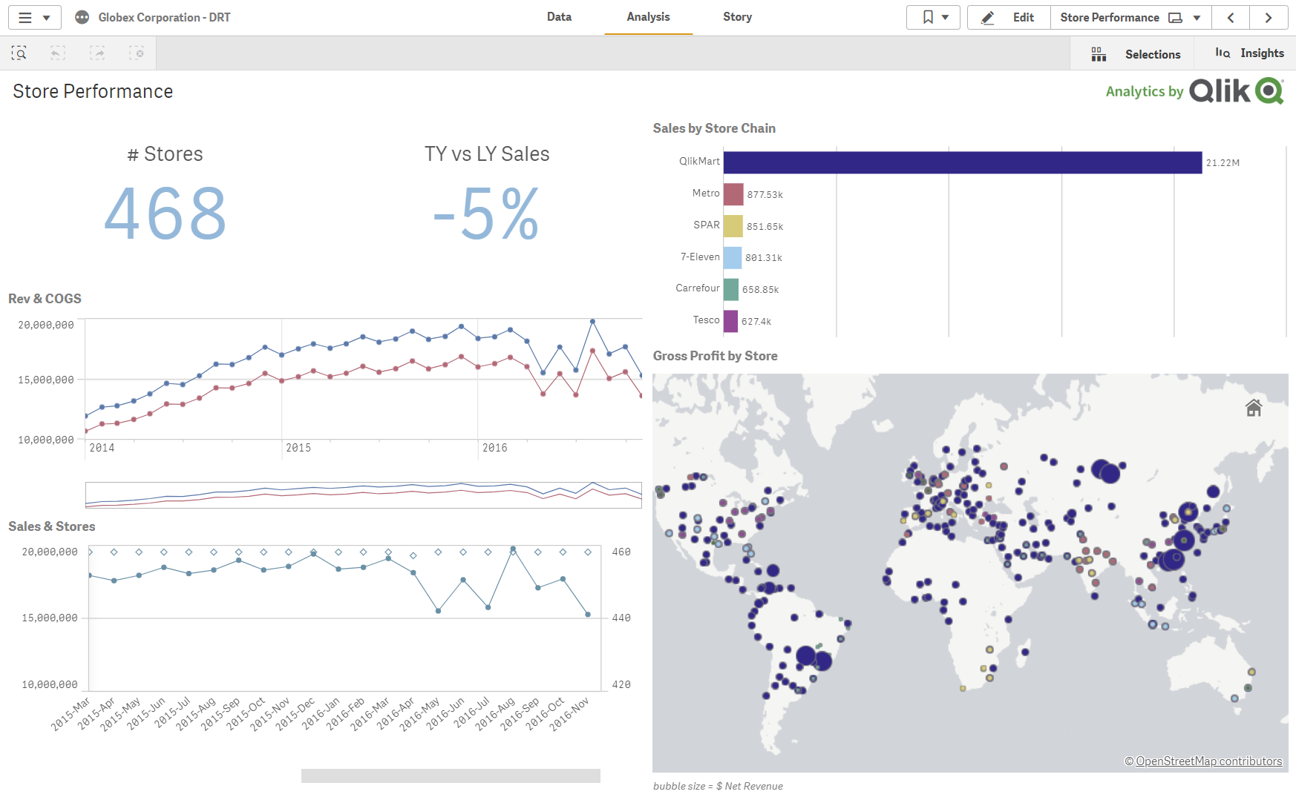
Qlik Alerting Workflow
Insight / Action
Enterprise Data Sources
Qlik Sense
Qlik Alerting
Insight / Action
Data
Analytics
Alerting
Notes:
Qlik Alerting runs alongside Qlik Sense, delivering alerts to users based on the data in Qlik Sense. It includes an alerting server, a robust, centralized application for creating and managing alerts, and a Qlik Sense user interface component for self-service alerting. Alerts can be delivered through a variety of channels, such as email or a dedicated mobile app.

Slide 13
Licensing
Qlik Alerting is a value-added product to Qlik Sense
Generally available (GA) now
Licensed on a per-site basis
Fixed, annual subscription price
Enables alerting for all Qlik Sense users of that site
Professional – Full users who can create, administer and receive
Analyzer – Create self-service alerts and receive alerts
Anyone – Receive broadcast (non-personalized) alerts only
SMB edition available for qualifying customers
Notes:
Qlik Alerting is generally available (GA) now. It is licensed on a per-site basis with a fixed, annual subscription price which enables alerting for all Qlik Sense users of that site based on their license type. Professional users are full users who can create alerts for others, administer alerting environments, and receive all types of alerts. Analyzer users can create self-service alerts and receive personalized alerts. And anyone registered in the Qlik Sense environment can receive broadcast (non-personalized) alerts. We also offer options for customers on older (token) licensing models, and an SMB edition available for qualifying customers.

Slide 14
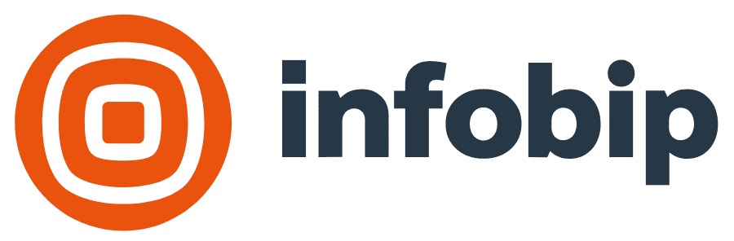
Existing Customers
Notes:
Even prior to acquisition, many notable Qlik customers were already using Qlik Alerting (formerly Ping). These customers range in size, and across all industries. Here is a sample of them.

Slide 15
Mobile sales teams are immediately notified on key customer account activity. This helps with timely engagement with key accounts.
Qlik Alerting Benefits
Benjamin Moore & Co., a Berkshire Hathaway company, is a high-performing, innovative manufacturer and retailer of quality coatings and provider of related goods and services for decoration and preservation. They are a leader in the architectural coatings industry with products that set new standards of excellence. They sell the finest paints, stains, and finishes through a network of more than 5,000 independent retailers across North America.
Benjamin Moore & Co. have over 500 Qlik Sense tokens and are predominantly allocated to mobile sales team members. Ping Intelligent Alerting helps Benjamin Moore & Co. sales reps proactively stay informed when key customer accounts place orders by receiving an intelligent alert directly on their mobile phones.
Mobile alerting direct to sales representatives on key customer account activity
Alerts to executive management allowing them to manage by exception
Self-service alert creation for business users directly from Qlik Sense dashboards
Helps increase Qlik usage and adoption
“Our mobile sales teams logged into Qlik Sense infrequently. To increase usage we started to deploy Qlik Sense Mobile, however this still relied on users logging into the dashboards, finding the right sheet and making the appropriate selections. With Qlik Alerting, sales teams now get proactively notified when something of interest happens and they can get to the detail that’s in Qlik Sense by simply clicking on a link in the alert.”
Mohsin Mahmood, Qlik Administrator, Benjamin Moore
Scope to extend out to self service data-driven alerts on performance management dashboard

Slide 16
Qlik Alerting lets Qlik admins know immediately if there’s a problem with a data refresh task. This ensures Qlik users always see the data they expect to see in Qlik Sense apps
Qlik Alerting Benefits
A globally well known, flat-pack furniture manufacturer and franchising company with stores located across EMEA, APAC and North America has been using Qlik Sense for several years. With over 150k Qlik Sense tokens they have ambitious plans ahead with regards to giving each employee access to a Qlik dashboard to measure performance. They have a dedicated Qlik development team and a separate Qlik Admin team. The Admin team are not technical and were looking for an easy-to-use interface to create system alerts so that they were notified immediately if there were any problems with Qlik Sense reload tasks. Implementing Ping Alerting helped reduce complaints from business users that came from failed Qlik application reloads.
Easy to user interface for Qlik Administrators
Ability to create alerts on different reload statuses
Alerts are delivered instantly through email and mobile phone apps
Helps increase Qlik user satisfaction and adoption
“Using the system alerts capability in Qlik Alerting at a global retail company ensured that Qlik apps were successfully reloaded every time. Implementing Qlik Alerting helped reduce complaints from business users that came through due to failed app reloads.”
Barry Harmsen, Chief Qlik Officer, Bitmetric (Qlik Partner)
Scope to extend out to self service data-driven alerts on performance management dashboard

